Slide 1
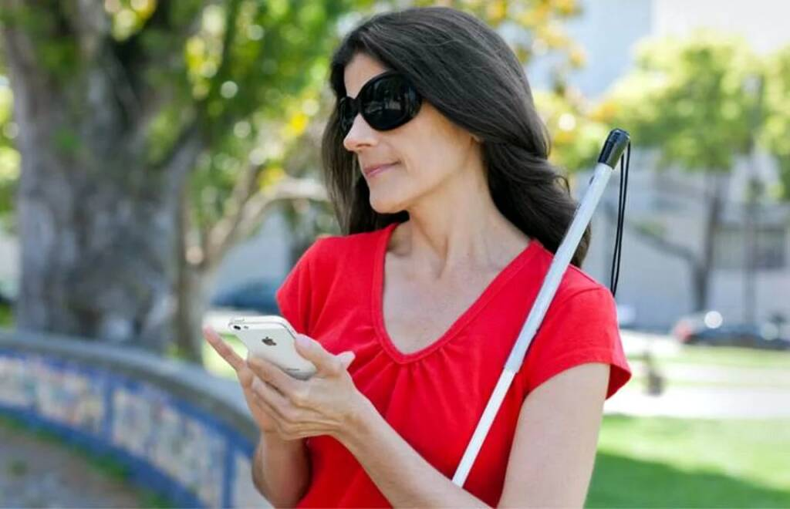

Promotion: Target Audience
Individuals
visually impaired and blind people from 20-40 years old
like to try new things and experiment
interested in technology and gadgets
prefer convenient and practical products
Private and public organizations such as:
Hospitals
Airports
Shopping centers
Non-profit organizations

Slide 2
Promotion: Marketing strategy
B2B marketing | Content marketing
demonstration shows and lectures participation in EXPO, forums Email marketing | creating a company website posting blogs uploading educational videos on YouTube Google search ads Social Media marketing

Slide 3
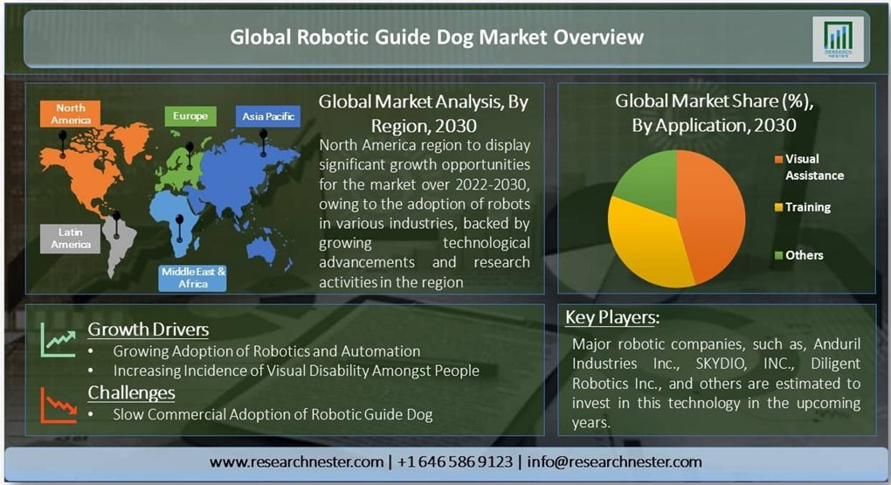
Price

Slide 4
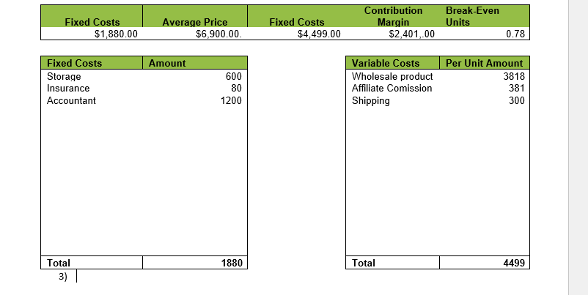
Price
Cost of goods sold = $4,000
Production time = 2 days
Packaging = $400
Shipping = $300
Promotional materials = $1,500
Affiliate commissions = 10%
Total per-product cost = $4,000 + $400 + $300 + $1,500 = $6,200
Profit Margin = 35%
Variable cost per product = $4,500
Target Price = $4,500/0.65 = $6,923

